Slide 1
Human Resource Analytics: Predicting which employee will leave the company

Slide 2



TRIPLINGs
Hardik Chheda ID:10420388
Jasmeet Rajpal ID:10415103
Advait Gupte ID:10415613

Slide 3
Motivation
Why our most experienced and best employees leaving te company prematurely?
What kind of employees will leave next?
Can we do anything to help keep them in the company?

Slide 4
Data
Source:-Human Resource Analytics(https://www.kaggle.com/ludobenistant/hr-analytics)
14999 rows of data
10 columns

Slide 5
Columns
Satisfaction level
Last Evaluation
Number of Projects
Average monthly hours
Time spent at the company
Work Accident
Promotion(in last 5 years)
Department
Salary
Left(target variable)

Slide 6
Data Preprocessing
Categorical variable
Variable needs to be numerical to find to be able to find the distance
Two categorical variables: Salary, Department
Converted above categorical variables by adding extra Columns
Salary:
Salary has 3 Categories :High, Medium, Low
Adding 3 Columns: salary_high, salary_medium, salary_low
Columns have value equal to 1 if the column matches the category and 0 Otherwise

Slide 7
Data Preprocessing
Department
Department has 10 Categories: sales, accounting, hr, technical, support, management, IT, product_mng, marketing, RandD
Adding 10 columns : sales, accounting, hr, technical, support, management, IT, product_mng, marketing, RandD
Columns have value equal to 1 if the column matches the category and 0 Otherwise
Eg: sales column becomes 1 when Department is Sales and other columns becomes
Normalized all columns

Slide 8

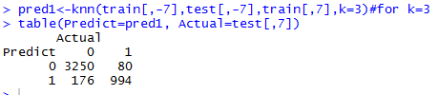
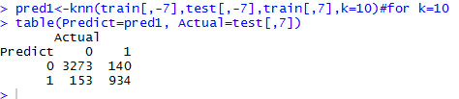
K- Nearest Neighbor Classification
For k=2
For k=3
For k=10

Slide 9

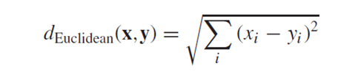
K- Nearest Neighbor Classification
For k=55
Neighbors are defined on basis of distance metric. I.e. Euclidean distance:
Best result for k=2

Slide 10
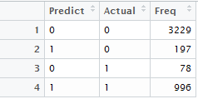
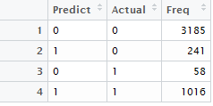
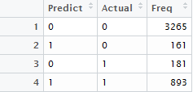
Weighted K-Nearest Neighbors (KKNN)
For k=2
For k=3
For k=55

Slide 11
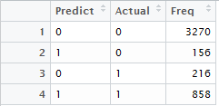

Weighted K-Nearest Neighbors (KKNN)
For k=75
K nearest training set vectors are found using, Minkowski distance function=
Best result for k=2

Slide 12
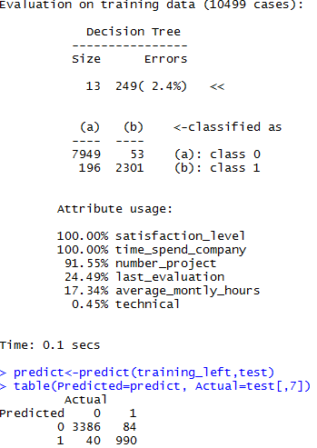
C5.0
Fit classification tree model using Quinlan’s C5.0 algorithm.
Provides separate branch for each field value
Accuracy: 97.244%

Slide 13
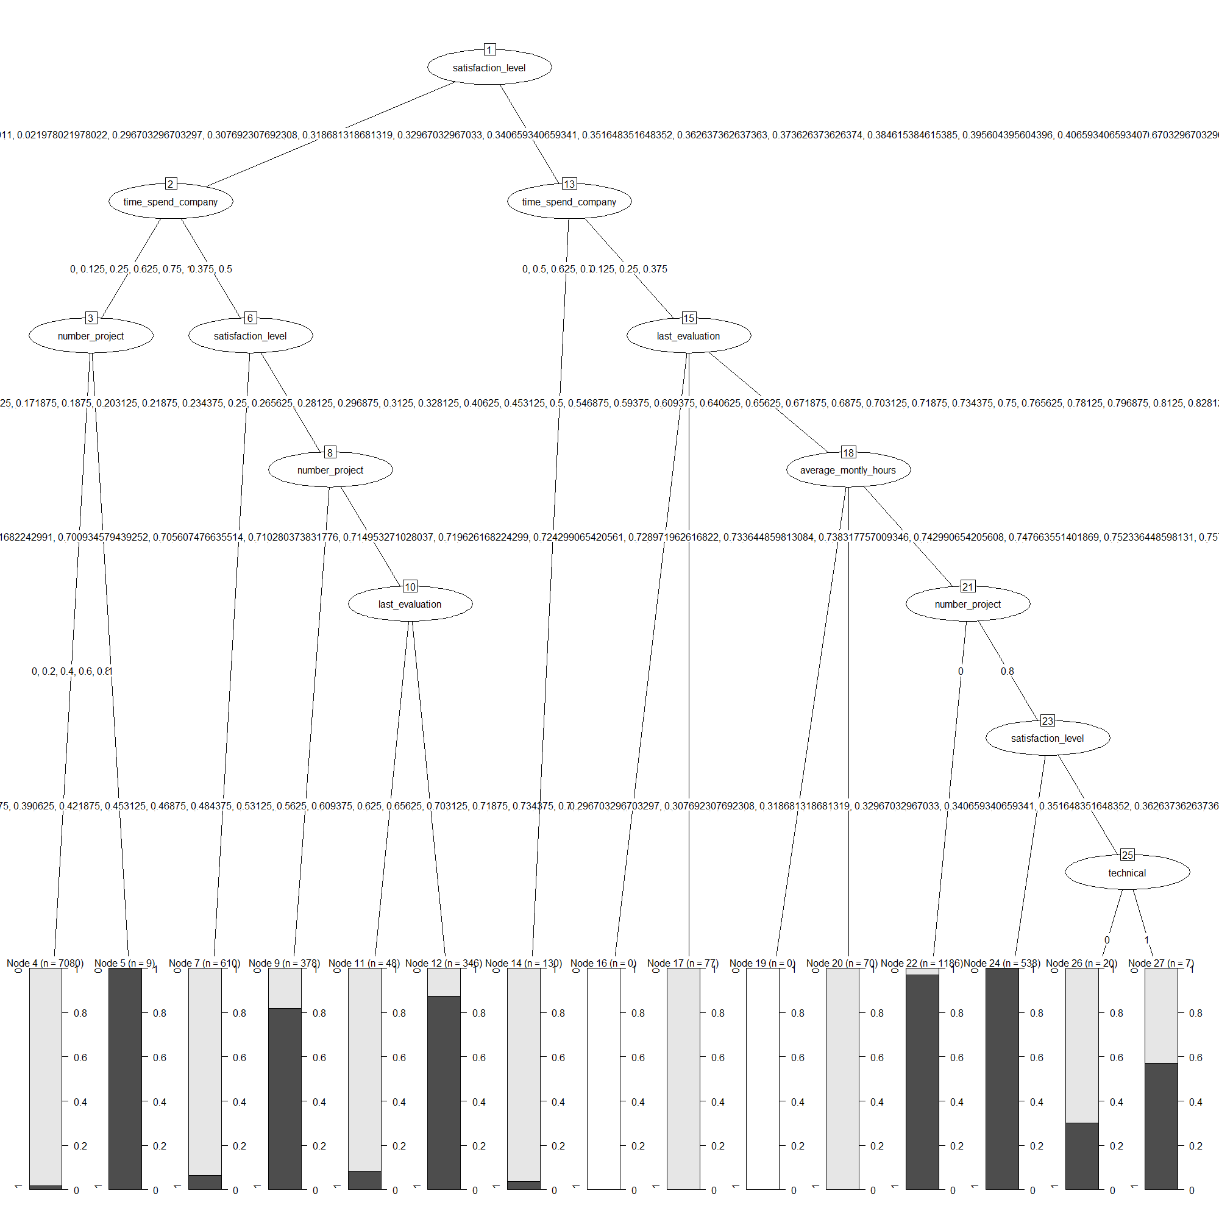
C5.0
Decision Tree

Slide 14
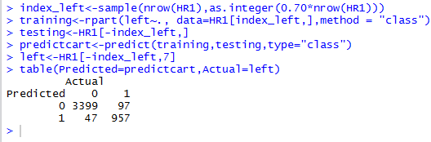
Classification and Regression Tree(CART)
Uses historical data to construct decision trees
Identify the most significant variables and eliminate non-significant ones.

Slide 15
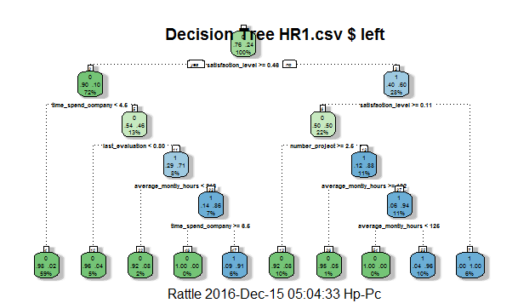
Classification and Regression Tree(CART)

Slide 16
Comparison of models
Based on the observation we can conclude that C5.0 best fits our dataset model as have obtained highest accuracy rate for it.
Satisfaction_Level is the most important factor to decide that the employee will leave the company (using CART results)
Algorithms | Accuracy
KNN(K=2) | 94.688%
KKNN(K=2) | 93.88%
C5.0 | 97.244%
CART | 96.8%

Slide 17
THANK YOU

